Slide 1
MODULE – 2
Input/Output Operation in Java

Slide 2
Syllabus
Input/output operation in java (java.io), Streams and the new I/O capabilities, understanding streams, working with file object, file I/O basics, reading and writing to files, buffer and buffer management, read/write operations with file channel, serializing objects, observer and observable interfaces.

Slide 3
Contents
Introduction of I/O operations
Stream
The java.io.* package
File operations
Channel and Buffer usages
Serialization of network objects
Observer and Observable interfaces (Knowledge level)

Slide 4
Introduction

Slide 5
I/O Introduction
I/O (Input/Output) is used to read data from a source and write data to a destination.
In this context it is input to and output from programs
Input can be from keyboard or a file
Output can be to display (screen) or a file
Advantages of file I/O
permanent copy
output from one program can be input to another
input can be automated (rather than entered manually)

Slide 6
Binary Versus Text Files
All data and programs are ultimately just zeros and ones
each digit can have one of two values, hence binary
bit is one binary digit
byte is a group of eight bits
Text files: the bits represent printable characters
one byte per character for ASCII, the most common code
for example, Java source files are text files
so is any file created with a "text editor"
Binary files: the bits represent other types of encoded information, such as executable instructions or numeric data
these files are easily read by the computer but not humans
they are not "printable" files
actually, you can print them, but they will be unintelligible
"printable" means "easily readable by humans when printed"

Slide 7
Text file: an example
Some description
----------------------
Abc 222

Slide 8
Binary file: an example [a .class file]
0000000 312 376 272 276 000 000 000 061
312 376 272 276 \0 \0 \0 1
0000010 000 164 012 000 051 000 062 007
\0 t \n \0 ) \0 2 \a
0000020 000 063 007 000 064 010 000 065
\0 3 \a \0 4 \b \0 5
0000030 012 000 003 000 066 012 000 002
\n \0 003 \0 6 \n \0 002
...
0000630 000 145 000 146 001 000 027 152
\0 e \0 f 001 \0 027 j
0000640 141 166 141 057 154 141 156 147
a v a / l a n g
0000650 057 123 164 162 151 156 147 102
/ S t r i n g B
0000660 165 151 154 144 145 162 014 000
u i l d e r \f \0

Slide 9
Files & Directories

Slide 10
File Class
File class describes the properties of a file/directory.
A File object is used to obtain or manipulate the information associated with a disk file, such
as the permissions, time, date, and directory path, and to navigate subdirectory hierarchies.
An absolute file name (full name) contains a file name with its complete path and drive letter.
For example, c:\books\welcome.pdf
A relative file is in relation to the current working directory.
For example, welcome.pdf

Slide 11
File Class
The file class is a wrapper class for the file name and its directory path.
for example,
new File(“c:\\book”) , it creates a File object for the directory c:\book
new File(“c:\\book\\test.dat”) , it creates a File object for the file c:\book\test.dat
The following constructors can be used to create File objects:
File(String directoryPath)
File(String directoryPath, String filename)
File(File dirObj, String filename)
File(URI uriObj)
File class does not contain the methods for reading and writing file contents.

Slide 12
File Class, methods
Boolean isFile()
Boolean isDirectory()
Boolean isHidden()
Boolean exists()
Boolean canRead()
Boolean canWrite()
String getName()
String getPath()
String getAbsolutePath()

Slide 13
Exercise 1 : Demonstrating File (Class, COnstructors & Methods)

Slide 14
Output

Slide 15
File class , for a folder/directory
A directory in Java is treated simply as a File with one additional property—a list of filenames that can be examined by the list( ) method.

Slide 16
Exercise2 : Demonstrating directories

Slide 17
Output

Slide 18
Reading and Writing Files
In Java, all files are byte-oriented, and java provides methods to read and write bytes from and to a file.
Java allows us to wrap a byte-oriented file stream within a character-based object.
We can use Scanner and PrintWriter class to read and write files.

Slide 19
PrintWriter Class
Character-based class.
Using a character-based class for console output makes it easier to internationalize the program.
PrintWriter(OutputStream outputstream, boolean flushOnNewline)
where Outputstream is an object of type OutputStream.
flushOnNewLine controls whether Java flushes the output stream every time a println() method is called.
If flushOnLine is true, flushing automatically takes place.
If false, flushing is not automatic.

Slide 21
Scanner Class
To read from the keyboard, we create a Scanner as follows:
Scanner sc=new Scanner(System.in);
To read from a file, create a Scanner for a file, as follows:
Scanner sc=new Scanner(new File(filename));
Scanner Methods: next()
nextLine()
nextInt()
……

Slide 23
Output

Slide 24
I/O Streams

Slide 25
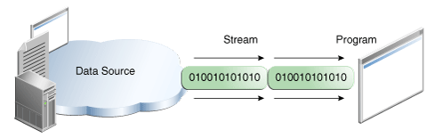
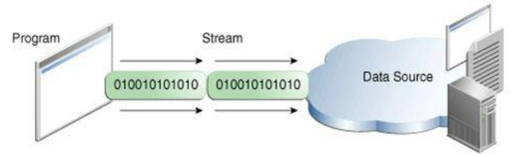
Streams
Stream: an object that either delivers data to its destination (screen, file, etc.) or that takes data from a source (keyboard, file, etc.)
it acts as a buffer between the data source and destination
Input stream: a stream that provides input to a program
System.in is an input stream
Output stream: a stream that accepts output from a program
System.out is an output stream
A stream connects a program to an I/O object
System.out connects a program to the screen
System.in connects a program to the keyboard
Input stream
output stream

Slide 26
Streams Types
ByteStreams
Works with bytes and binary objects
InputStream class for read operation
OutputStream class for write operation
Java defines two different types of Streams-
ByteStream
CharacterStream
CharacterStreams
Works with characters and strings
Reader class for read operation
Writer for write operation

Slide 27
Byte Streams
Programs use byte streams to perform input and output of 8-bit bytes
Byte streams are defined by using two class hierarchies
At the top, there are two abstract classes : InputStream and OutputStream
The abstract classes InputStream and OutputStream define several key methods that the other stream classes implement
Two of the most important methods are read() and write() , which respectively read and write bytes of data
Both methods are declared as abstract inside InputStream and OutputStream
It is important that we have used a finally block to guarantee that both streams will be closed even if an error occurs. This helps resource leaks.
When we call the close() , it clears buffer by performing the write operation to the destination and then closes the stream.

Slide 28
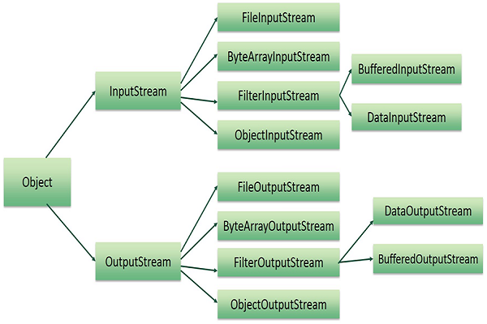
Byte Stream classes
The following are the child classes for InputStream and OutputStream

Slide 29
Byte Stream : InputStream and OutputStream classes
The following are the child classes for InputStream and OutputStream.
BufferedInputStream : contain methods to read from input stream buffer
BufferOutputStream : to write
DataInputStream : contain methods for reading the Java standard data types
DataOutputStream : contain methods for writing the Java standard data types
FileInputStream : Input stream that reads from a file
FileOutputStream : output stream the writes to a file
InputStream : abstract class that describes stream inputs
OutputStream : abstract class that describes stream outputs
PrintStream : output stream that contains print() and println()
PipedInputStream : Input pipe
PipedOutputStream : Output pipe

Slide 30
Byte Stream : InputStream Methods
The following are the methods for InputStream.
int available()
void close()
void mark(int numbytes)
int read()
int read(byte buffer[])
void reset()

Slide 31
Byte Stream : OutputStream Methods
The following are the methods for OutputStream.
void close()
void flush()
void write(int b)
void write(byte[] buffer)
void write(byte[] buffer, int offset, int numBytes)

Slide 32
Byte Stream : File operation
FileInputStream and FileOutputStream are stream classes which create streams linked to files.
Constructor
FileInputStream(String filename) throws FileNotFoundException
FileInputStream(File fname) throws FileNotFoundException
FileOutputStream(String filename) throws FileNotFoundException
FileOutputStream(File fname) throws FileNotFoundException
FileOutputStream(String filename, boolean append) throws FileNotFoundException
FileOutputStream(File fname, boolean) throws FileNotFoundException

Slide 33
Byte Stream : File operation
To read from a file , we can use read() that is defined within FileInputStream
int read() throws IOException
Each time read() is called, it reads a single byte from the file and returns the byte as an integer value.
To write a file, we can use the write() method defined by FileOutputStream.
void write(int bytevalue) throws IOException

Slide 34
FileinputStream / FileOutputStream Demo Program

Slide 35
Output

Slide 36
BufferedInputStream / BufferedOutputStream Demo Program

Slide 37
Output

Slide 38
File Streams vs Buffered Streams
File Streams | Buffered Streams
Direct file access | Uses memory buffer
Slower | Faster
Reads byte-by-byte from file | Reads chunk-wise
Simple | Efficient
Used for small data | Used for large data

Slide 39
Character Streams
Programs use character streams to perform input and output of 16-bit Unicodes that java supports.
Character streams are defined by using two class hierarchies
At the top, there are two abstract classes : Reader and Writer
The abstract classes Reader and Writer define several key methods that the other character classes implement

Slide 40
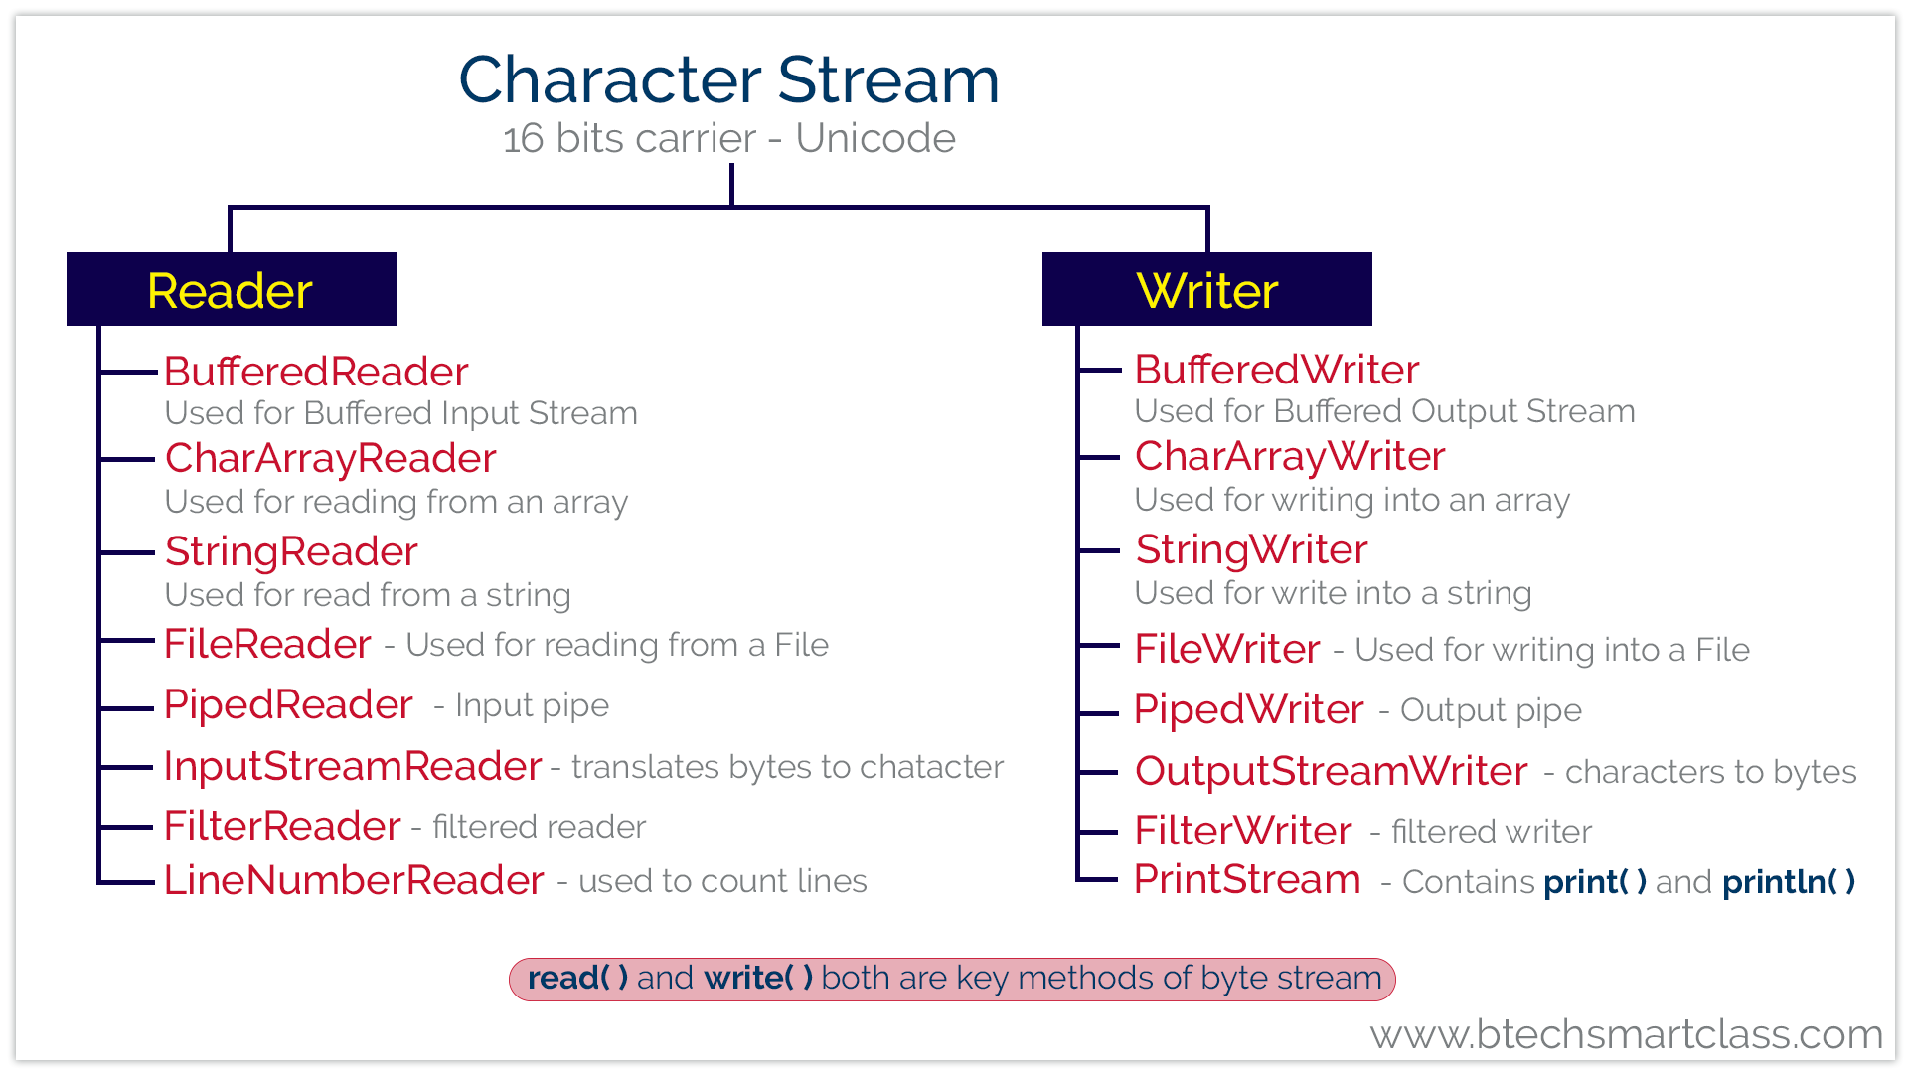
Character Streams
The following are the child classes for Reader and Writer

Slide 41
Character Streams : Reader Class
The abstract classes Reader define several key methods that the other character classes implement.
The subclasses those implements the method of Reader are
BufferedReader : read characters from buffer
CharArrayReader : read characters from character array
FileReader : read characters from the file
FilterReader : read characters from the character input stream
InputStreamReader : converts bytes to character
PipedReader : read characters from a piped output stream
StringReader : read characters from a string

Slide 42
Character Streams : Reader Methods
The abstract classes Reader define several key methods that the other character classes implement.
Methods declared abstract in Reader classes are :
int read()
int read(char[] buffer)
int read(char[] buffer, int loc, int nchars)
void reset()
void close()

Slide 43
Character Streams : Writer Class
The abstract classes Writer define several key methods that the other character classes implement.
The subclasses those implements the method of Writer are
BufferedWriter : write characters to buffer
FileWriter : write characters to file
CharArrayWriter : write characters to the character array
OutputStreamWriter : converts bytes to character
PipedWriter : write characters to a piped output stream
StringWriter : write characters to a string

Slide 44
Character Streams : Writer Methods
The abstract classes Writer define several key methods that the other character classes implement.
Methods declared abstract in Writer classes are :
void write()
void write(int i)
void write(char[] buffer, int loc, int nchars)
void flush()
void close()

Slide 45
FileReader / FileWriter Demo

Slide 46
BufferedReader / BufferedWriter Demo

Slide 47
StringReader / StringWriter Demo

Slide 48
PipedReader / PipedWriter
Used to transfer data between two threads

Slide 50
Channel & Buffer

Slide 51
NIO api : introduced channel and Buffer
Drawbacks of traditional java.io.*
Lacks some important functionality , such as copy() not available in File class
Defined many methods that returns boolean. In case of error , instead of exception, method returns false.
A limited set of file attributes was provided.
Features of java.nio.*
Added with java 6/ jdk 6
Stands for non blocking i/o
Bulk access to raw bytes
Bidirectional channels
Introduces three new concepts : Channel, Buffer and Selector

Slide 52
Channel
The channel is where the data comes from.
The channel object is an object that connect to a file .
A channel can write the buffer to the medium or can read data from that medium to a buffer.
In Java , Channel is an interface
Implemented by FileChannel, DatagramChannel, SocketChannel

Slide 53
Channel : FileChannel
A FileChannel can be mapped to a memory array for direct access. This allows for much faster operation than accessing to the disk directly.
It is built on native features provided by the different operating system and this is the reason why the concrete implementation of FileChannel are hidden just bcz they are different depending on the machine we are working on.
There are 3 modes of operation by a channel
READ_ONLY
READ_WRITE
PRIVATE

Slide 54
Buffer
A buffer can be seen as a space in memory. It can reside in the main memory of the JVM.
A buffer object has 3 properties:
a capacity = the size of the backing array.
a current position that can be seen as cursor. All the read and the write operations are made to or from the current position.
a limit which is the last position in memory seen by this buffer.
A buffer supports 4 operations:
rewind: clears the mark and sets the current position to 0.
reset: sets the current position to the previously set mark. This is the companion method of the mark method.
flip: sets the limit to the current position and rewinds the buffer.
clear: clears the buffer.

Slide 55
Buffer
Buffer is an abstract class in java.
Extended by ByteBuffer, CharBuffer,

Slide 56
Exercise : Writing content to a file using Buffers and Channels
Steps:
Create a ByteBuffer.
use the putXXX() method to write data.
have our FileChannel to write the ByteBuffer to a file.

Slide 57
Serialization

Slide 58
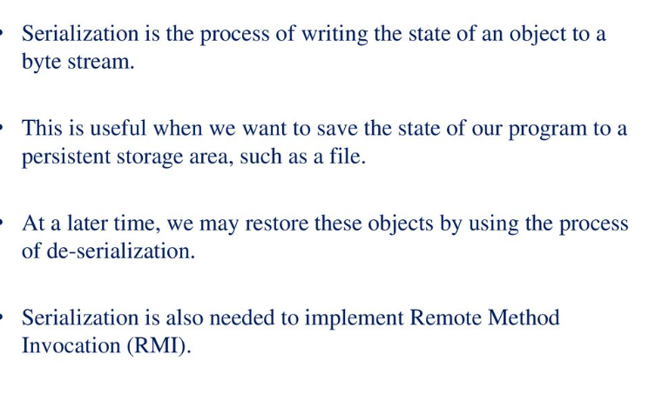
Serialization

Slide 59
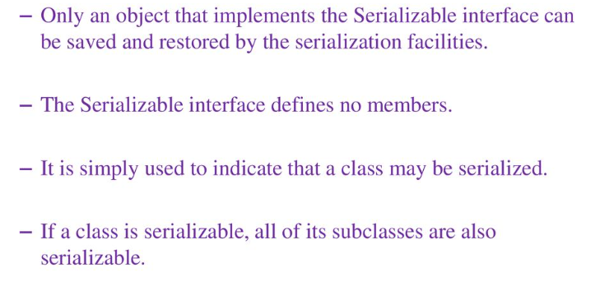
Serializable Interface

Slide 60
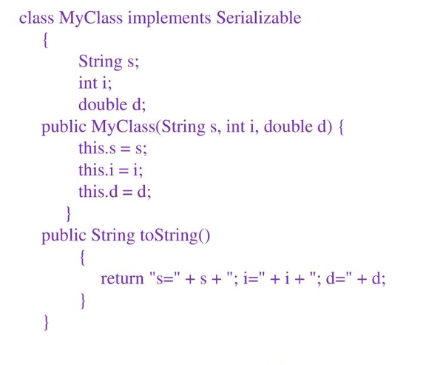
Serialization Example

Slide 61
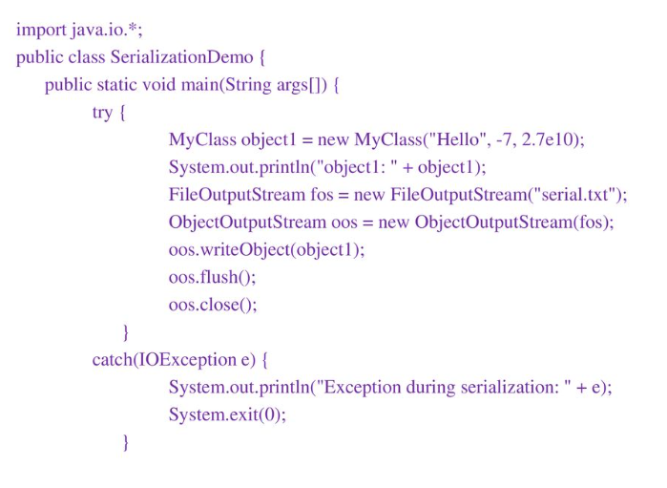
Serialization Example

Slide 62
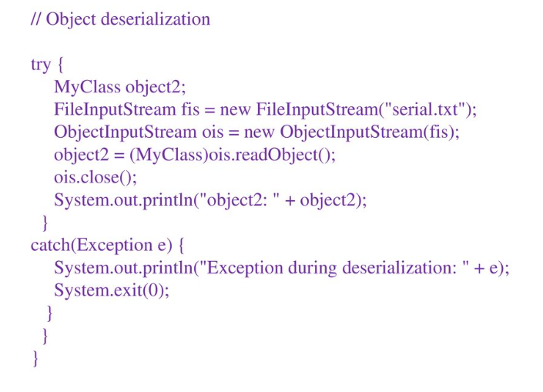
Serialization Example

Slide 63
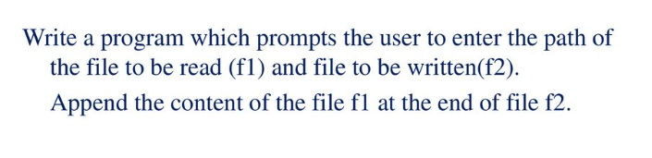
Exercise

Slide 64
Observer and Observable Interface
Observer and Observable are deprecated from Java 9
The Java language supports the MVC architecture with two classes:
Observer : Any object that wishes to be notified when the state of another object changes
Observable : Any object whose state may be of interest, and in whom another object may register an interest.
Used in Notification Process

Slide 65
Observable is a class, not an interface
Observer is an interface
Observable - Maintains observers
Observer - Gets updates
addObserver() - Register observer
setChanged() - Marks change
notifyObservers() - Notifies all

Slide 68
Module – 2 Completed

